Slide 1
HUMAN COMPUTER INTERACTION.
IN CLASS ACTIVITY.

Slide 2
NORMAN’S 7 PRINCIPLES.

Slide 3
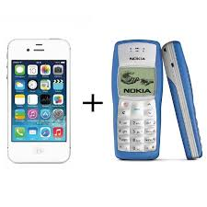
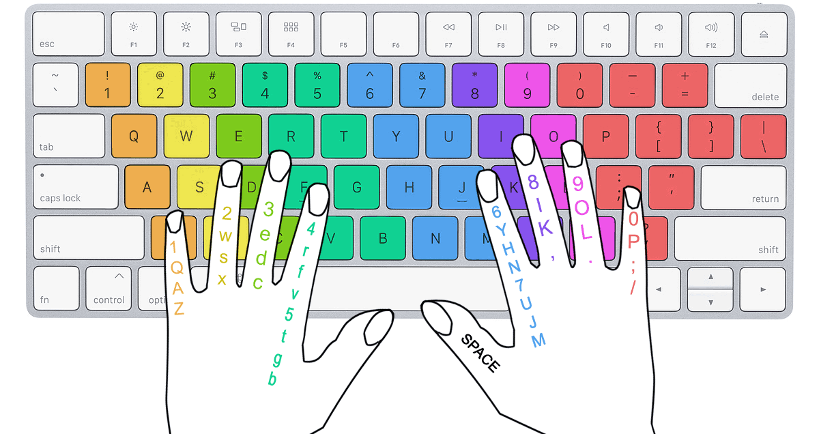
1.Use both knowledge in the world and knowledge In the head.
People work better when the knowledge they need to do a task is available externally – either explicitly or through the constraints imposed by the environment. But experts also need to be able internalize regular tasks to increase their efficiency.
Different key board styles present.
Example:
1100 Mobile phone keyboard vs. Touch screen keyboards available.
Letters on a keyboard vs. knowledge of touch typist.

Slide 4
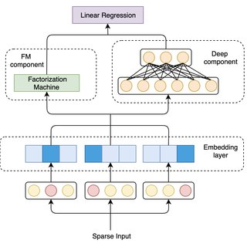
2.Simlify the structure of tasks.
Tasks need to be simple in order to avoid complex problem solving and excessive memory load.
Example:
Breakdown into simpler structure or automate.
Wide vs. deep structure.

Slide 5
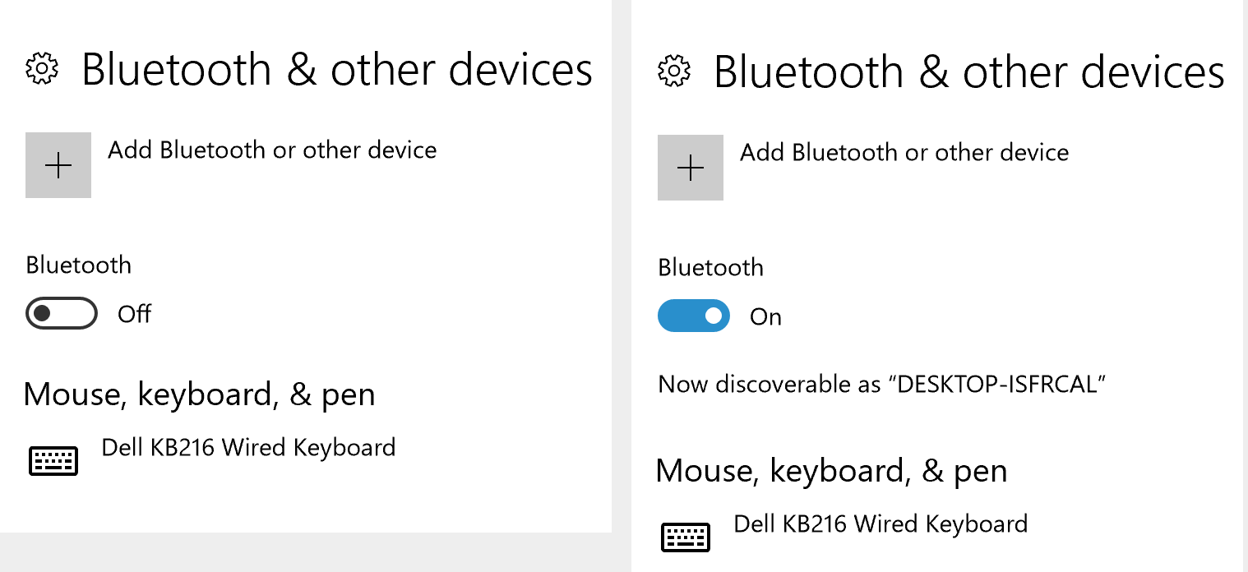
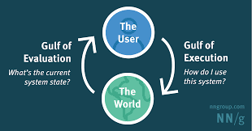
3.Make things visible: bridge the gulfs of Execution and Evaluation.
The interface should make clear what the system can do and how this is achieved, and should enable the user to see clearly the effect of their actions on the system.
The expectations and the availability of information specifying the state of the world (or an artifact) and how me may change it.
Example:
When an application has a spinning wheel to show a “loading” state after the user performs an action.

Slide 6
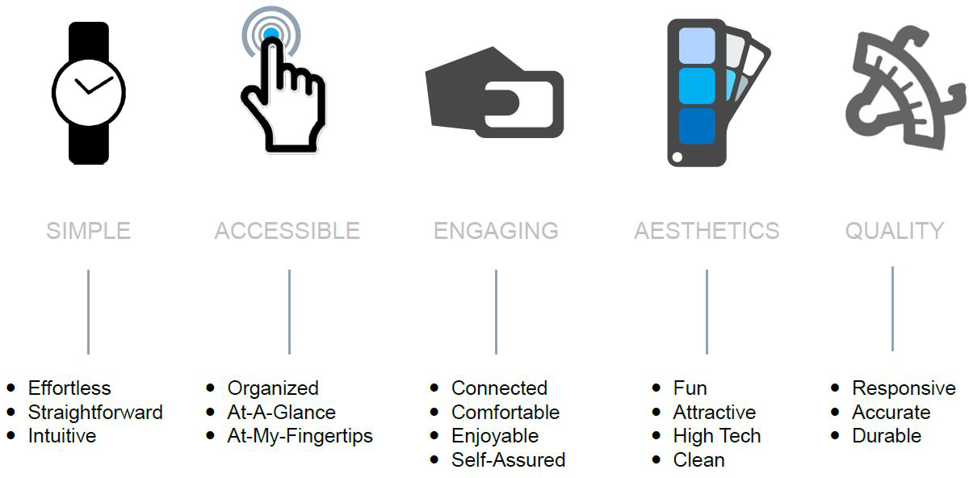
4.Get the mappings right.
User intentions should map clearly onto system controls. User actions should map clearly onto system events. So it should be clear what does what and by how much. Controls, sliders and dials should reflect the task – so a small movement has a small effect and a large movement a large effect.
Example:

Slide 7
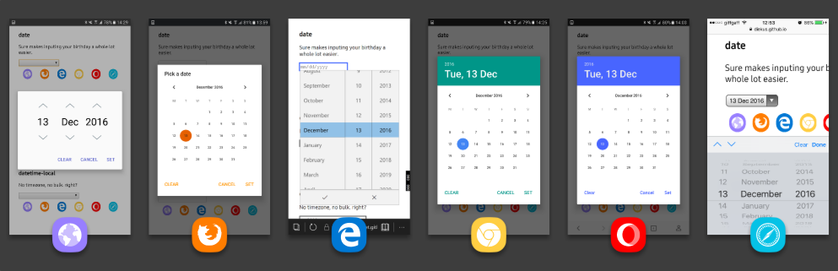
5.Exploit the power of constraints, both natural and artificial.
Information overload.
Long forms.
Complicated layouts.
Heavily written descriptions.
Limiting the range of interaction possibilities for the user to simplify the interface and guide the user to the appropriate next action.
Example:
Avoid entering dashes, dots in dates, constraints in date time formats.

Slide 8
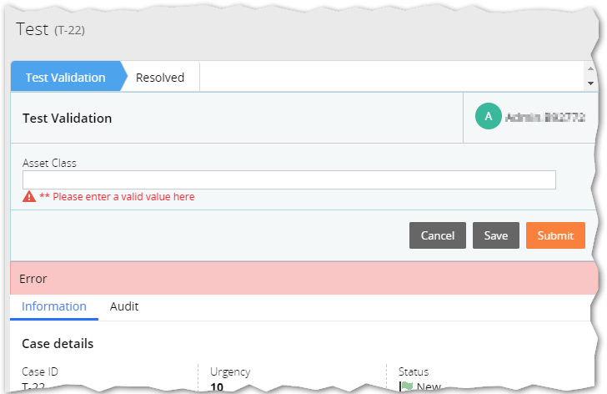
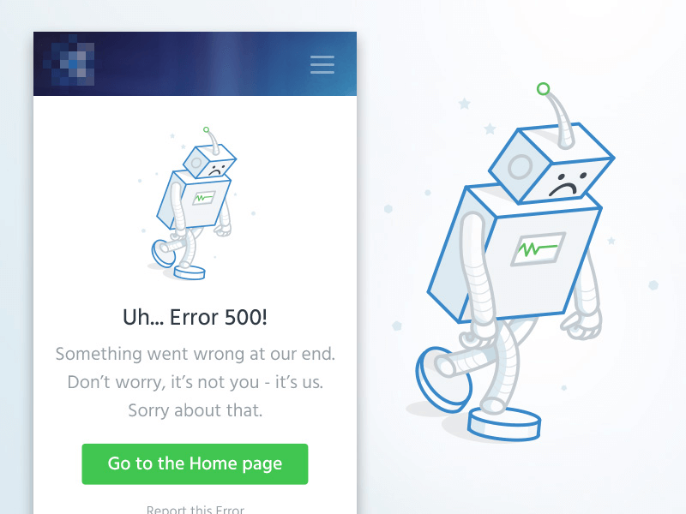
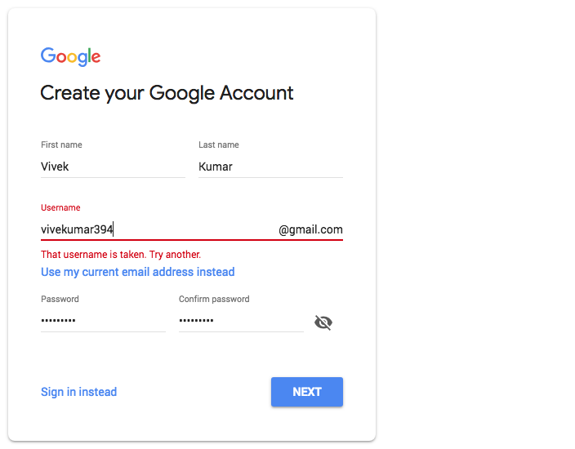
6.Design for error.
To error is human, so anticipate the errors the user could make and design recovery into the system.
Example:
Make undo easier.
Predefined format for inputs.
Make it simple and convenient for users to correct invalid inputs.

Slide 9
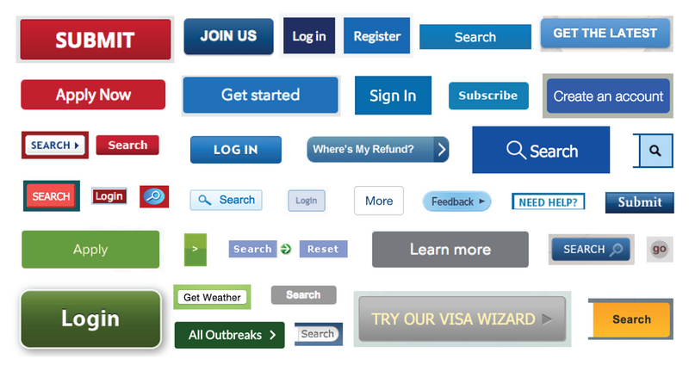
7.When all else fails, standardize.
Key controls are standardized.
By leveraging consistent elements through your entire experience, you make your experience for easier to use.
Example:
Poor consistency.

Slide 10
Plymouth ID | Plymouth Name
10707375 | Balage Silva
10707362 | Saunda Sanjula.
10707193 | Ruhunu Fernando.
10707202 | Sasindu Gamage.
10707428 | Ran Yasiru.
10707297 | Godalla Pathirana.

Slide 11


